Slide 1
EDU 6307: Emerging Issues in Education
Ruby Coleman
Texas Wesleyan University
October 19, 2020
Violence and Bullying in the School: Treatable or Beyond School Control

Slide 2
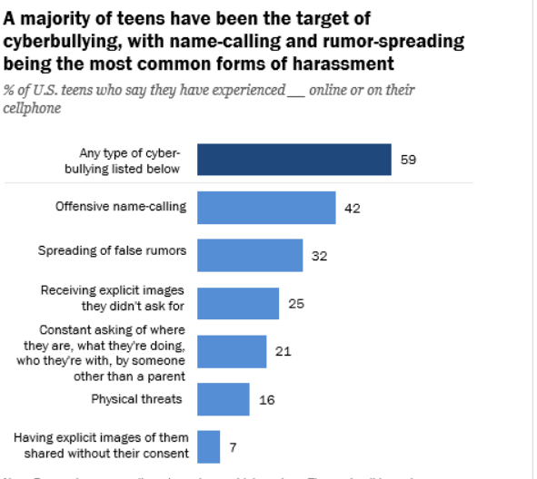
Violence and Bullying in the School: Treatable
Violence and bullying in the school is treatable if we cut down on social media access after the hours that students aren’t at school. “Messages about aggressive behavior enter the world of children no matter how hard parents try to screen them out” (Nelson, 2017, Pg. 335) When students don’t have to worry about the negative things they are seeing around them, less problematic situations will occur. One way to prevent cyberbullying students can participate in extracurricular activities that suits their personality.

Slide 3
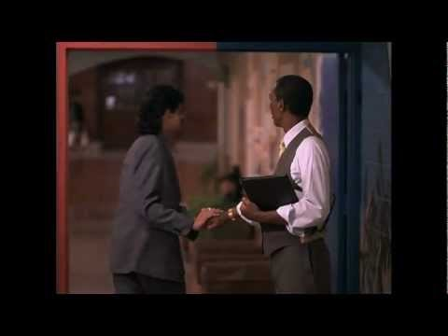
Violence and Bullying in the School: Beyond School Control
“School is a safe place, but disruptive students do exist.” (Nelson, 2017, Pg. 343) When I think about is Violence and Bullying Beyond School Control, I think about the movie, Lean On Me. Sometimes as Administrators, Educators, and etc., we try to defuse the conflict as quickly as we can. However, there are a lot of laws and compliance trainings that prevents faculty and staff from actually resolving the issues. Just like on the movie, Lean On Me, there will be some teachers that are for change, and there will be some teacher who blames administration for making it worse: the question is which one are you?

Slide 4
Reflections
1. The most common consequence of bullying is suspension, do you think Suspension works? Why or Why not?
2. Besides compliance videos, what other information do you think will be helpful to make sure the educator is involved?
3. What kind of interventions can young people use to prevent or stop bullying?

Slide 5
Reference
Nelson, J. L., Palonsky, S. B., & McCarthy, M. R. (2017). Critical Issues in Education: Dialogues and Dialectics, Eighth Edition (8th ed.). Waveland Press, Inc.
https://www.pewresearch.org/internet/2018/09/27/a-majority-of-teens-have-experienced-some-form-of-cyberbullying/

